Slide 1
INTRODUCTION
OBJECTIVE
REVIEW 2
REVIEW 3
RESULTS
CONCLUSION
DATA MINING TECHNIQUES REVIEW 3
ITE2006
E1+TE1
Movie Success Prediction System using Data Mining

Slide 2
INTRODUCTION
OBJECTIVE
CLASSIFICATION
REQUIREMENTS
FEATURES
ADVANTAGES
TEAM MEMBER
NAME | REG NO
JEBARAJ.M | 15BIT0354
Faculty : Prof .Thippa Reddy

Slide 3
Overview
INTRODUCTION
OBJECTIVE
REVIEW 2
REVIEW 3
RESULTS
CONCLUSION
Introduction
Objective
Abstract
Review 1
Review 2
Review 3
Results
Conclusion

Slide 4
Introduction
INTRODUCTION
OBJECTIVE
REVIEW 2
REVIEW 3
RESULTS
CONCLUSION
The Indian movie industry produces the maximum number of movies per
year at 1000/year, higher than any other country’s movie industry.
The IMDb is an excellent resource to find detailed information about
almost any film ever made. It contains a vast amount of data, which
undoubtedly contains much valuable information about general trends in
films.
Data mining techniques allows us to predict the success of a future film
given select information about the film before its release. So we will get the
data from IMDb and predict the movie success by applying the
mathematical concept.

Slide 5
Objective
INTRODUCTION
OBJECTIVE
REVIEW 2
REVIEW 3
RESULTS
CONCLUSION
India, is a movie fanatic nation, but there is no composite movie
database or a credible source for movie-ratings
This system answers the follwing question
1. Do Super-stars matter ?
2. Do Star director’s matter ?
3. Does Budget of a movie matter?
4. Do famous Writers, Producers matter?
By predicting the movie success user can easily decide whether
to book the ticket in advance or not. It will save the user time.

Slide 6
Abstract
INTRODUCTION
ABSTRACT
REVIEW 2
REVIEW 3
RESULTS
CONCLUSION
In this project I developed a mathematical model for predicting the success class such as flop, hit, super hit of the movies.
For doing this I have to develop a methodology in which the historical data of each component such as actor, director,writer and producer that influences the success or failure of a movie is given is due to weightage and then based on multiple thresholds calculated on the basis of descriptive statistics of dataset of each component it is given class flop, hit, super hit label.

Slide 7
Abstract
INTRODUCTION
ABSTRACT
REVIEW 2
REVIEW 3
RESULTS
CONCLUSION
Based on the weightage of historical data of each film crew the movie will be labeled as super hit, hit or flop.
This system helps to find out whether the movie is super hit, hit, flop on the basis of historical data of actor, actress, music director, writer, director, marketing budget and release date of the new movie.
The factors such as actor, director, writer, producer and marketing budget historical data of each component are calculated and movie success is predicted.
This mathematical model helps to find out the review of the new movie. Due to this model, user can easily decide whether to book ticket in advance or not.

Slide 8
Review 1
INTRODUCTION
OBJECTIVE
REVIEW 1
REVIEW 3
RESULTS
CONCLUSION
In review 1, I told our objective is find whether super star , famous director ,writer and producer are important or not for a success of a film.
As I said in review 2, I proved who was most important in a movie.

Slide 9
Review 2
INTRODUCTION
OBJECTIVE
REVIEW 2
REVIEW 3
RESULTS
CONCLUSION
In review 2, I proved the following using weka tool.
Writer > Director > Producer > Actor > Others
I have used NaiveBayes classifier for classification. The algorithm gave the the follwing result.
Film Crews | Super Hit Possibility %
Writer | 67%
Director | 56%
Producer | 36%
Actor | 25%

Slide 10
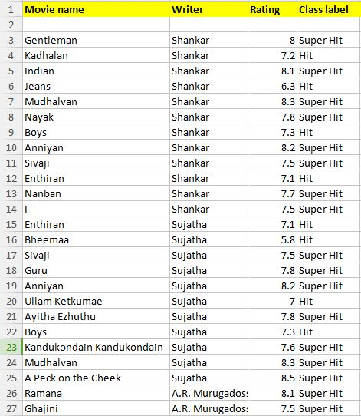
Writer
INTRODUCTION
OBJECTIVE
REVIEW 2
REVIEW 3
RESULTS
CONCLUSION

Slide 11
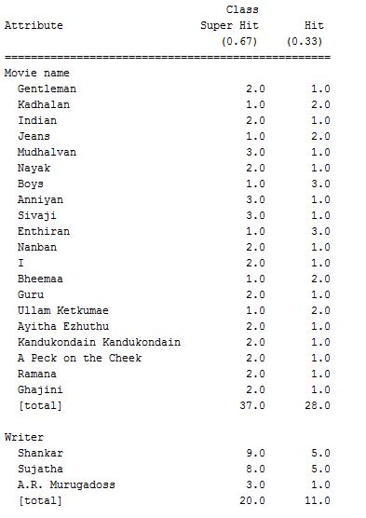
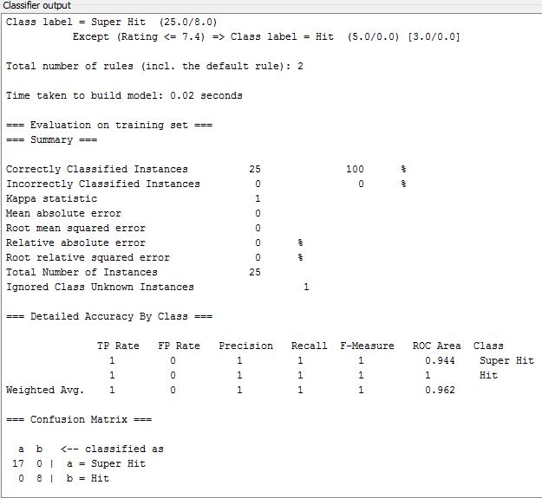
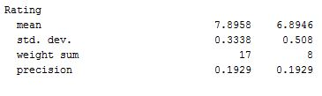
Writer-NaiveBayes
INTRODUCTION
OBJECTIVE
REVIEW 2
REVIEW 3
RESULTS
CONCLUSION

Slide 12
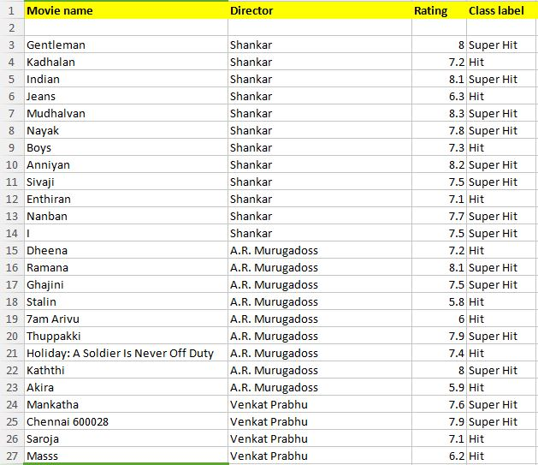
Director
INTRODUCTION
OBJECTIVE
REVIEW 2
REVIEW 3
RESULTS
CONCLUSION

Slide 13
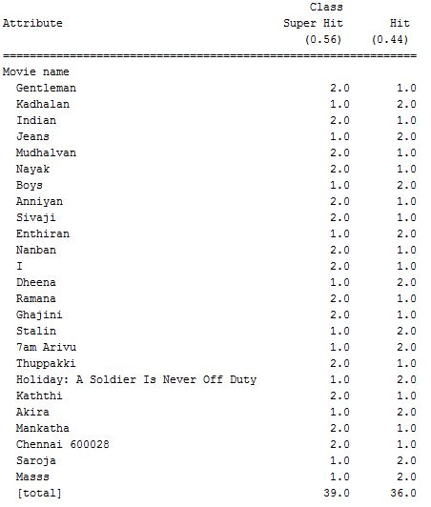
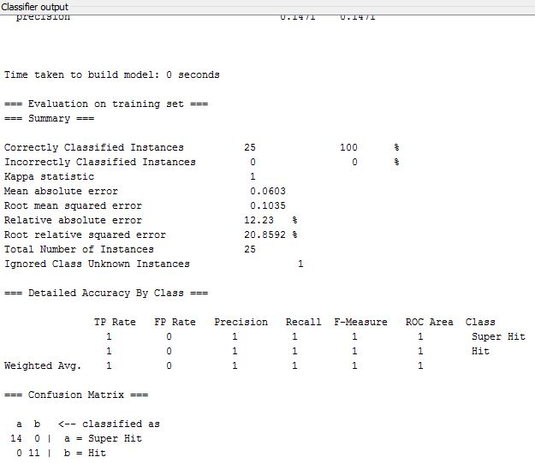
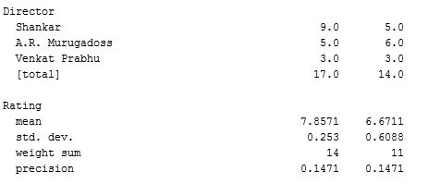
Director-NaiveBayes
INTRODUCTION
OBJECTIVE
REVIEW 2
REVIEW 3
RESULTS
CONCLUSION

Slide 14
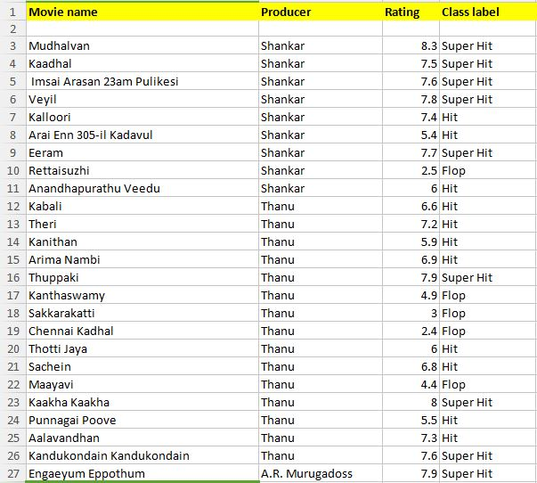
Producer
INTRODUCTION
OBJECTIVE
REVIEW 2
REVIEW 3
RESULTS
CONCLUSION

Slide 15
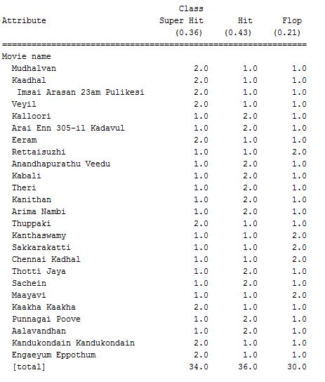
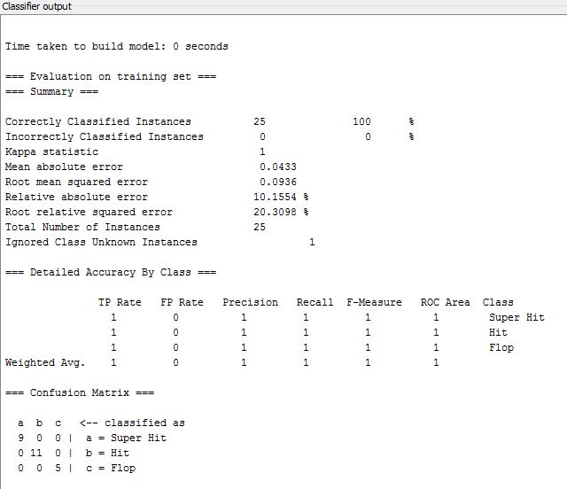
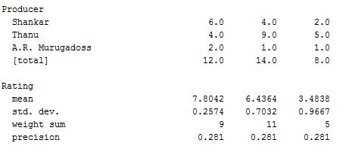
Producer-NaiveBayes
INTRODUCTION
OBJECTIVE
REVIEW 2
REVIEW 3
RESULTS
CONCLUSION

Slide 16
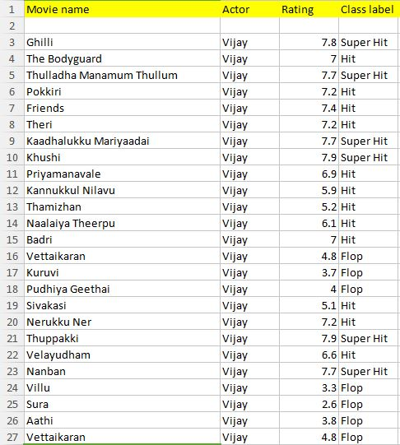
Actor
INTRODUCTION
OBJECTIVE
REVIEW 2
REVIEW 3
RESULTS
CONCLUSION

Slide 17
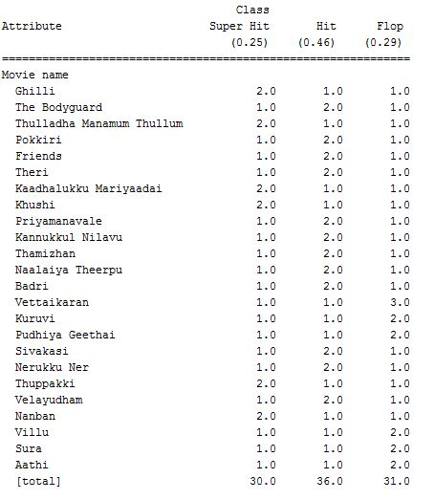
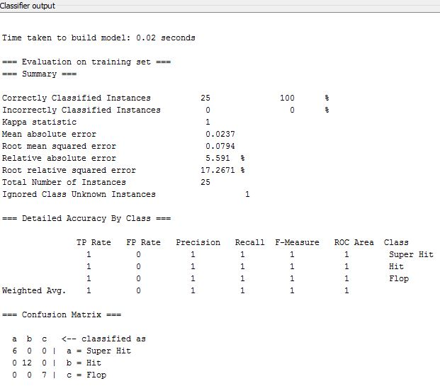
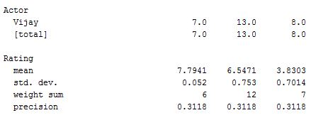
Actor-NaiveBayes
INTRODUCTION
OBJECTIVE
REVIEW 2
REVIEW 3
RESULTS
CONCLUSION

Slide 18
Review 3
INTRODUCTION
OBJECTIVE
REVIEW 2
REVIEW 3
RESULTS
CONCLUSION
In this review I developed the mathematical model for predicting the movie success using the review 2 results.
Steps followed:
1. Find the maximum weightage for each film crews.
(Writer, Director, Producer, Actor)
2. Find the maximum value assign for each class label for each film crews.
(Super Hit, Hit, Flop)
3. Based on historical data predict the class labels.

Slide 19
Find the weightage for each film crews
INTRODUCTION
OBJECTIVE
REVIEW 2
REVIEW 3
RESULTS
CONCLUSION
Writer+Director+Producer+Acor => 0.67+0.56+0.36+0.25 => 1.84
From weka overall I got weightage out of 1.84. Now I converted that out of 10(Max movie Rating) like follwing.
Finally 3.6+3.0+2.0+1.4=10.
Writer | (0.67/1.84)*10 = 3.6
Director | (0.56/1.84)*10 = 3.0
Producer | (0.36/1.84)*10 = 2.0
Actor | (0.25/1.84)*10 = 1.4

Slide 20
Assigning values for each class label
INTRODUCTION
OBJECTIVE
REVIEW 2
REVIEW 3
RESULTS
CONCLUSION
I assigned values of each film crew class labels.
I took random values for each class label like following.
Here 9.0 is maximum rated super hit movie from imdb.
7.4 is maximum rated hit movie from imdb.
2.5 is maximum rated flop movie from imdb.
Class Label | Values | Randomly we taken
Super Hit | 7.5<=x<10 | 9.0
Hit | 5<=x<7.5 | 7.4
Flop | 1<=x<5 | 2.5

Slide 21
Assigning values for each writer class label
INTRODUCTION
OBJECTIVE
REVIEW 2
REVIEW 3
RESULTS
CONCLUSION
Here I am going to assign values for each writer class labels as follows.
Writer Class Labels | Assigned Values
Super Hit (9.0) | (9/10)*3.6 = 3.24
Hit (7.4) | (7.4/10)*3.6 = 2.67
Flop (2.5) | (2.5/10)*3.6 = 0.9

Slide 22
Assigning values for each Director class label
INTRODUCTION
OBJECTIVE
REVIEW 2
REVIEW 3
RESULTS
CONCLUSION
Here I am going to assign values for each director class labels as follows.
Director Class Labels | Assigned Values
Super Hit (9.0) | (9/10)*3.0 = 2.70
Hit (7.4) | (7.4/10)*3.0 = 2.22
Flop (2.5) | (2.5/10)*3.0 = 0.75

Slide 23
Assigning values for each Producer class label
INTRODUCTION
OBJECTIVE
REVIEW 2
REVIEW 3
RESULTS
CONCLUSION
Here I am going to assign values for each producer class labels as follows.
Producer Class Labels | Assigned Values
Super Hit (9.0) | (9/10)*2.0 = 1.80
Hit (7.4) | (7.4/10)*2.0 = 1.48
Flop (2.5) | (2.5/10)*2.0 = 0.50

Slide 24
Assigning values for each Actor class label
INTRODUCTION
OBJECTIVE
REVIEW 2
REVIEW 3
RESULTS
CONCLUSION
Here I am going to assign values for each director class labels as follows.
Actor Class Labels | Assigned Values
Super Hit (9.0) | (9/10)*1.4 = 1.26
Hit (7.4) | (7.4/10)*1.4 = 1.04
Flop (2.5) | (2.5/10)*1.4 = 0.35

Slide 25
Finally
INTRODUCTION
OBJECTIVE
REVIEW 2
REVIEW 3
RESULTS
CONCLUSION
Here I am going to assign values for each director class labels as follows.
Film Crews | Max | Super Hit | Hit | Flop
Writer | 3.6 | 3.24 | 2.67 | 0.9
Director | 3.0 | 2.70 | 2.22 | 0.75
Producer | 2.0 | 1.80 | 1.48 | 0.50
Actor | 1.4 | 1.26 | 1.04 | 0.35
Total | 10 | 9 | 7.4 | 2.5

Slide 26
Explanation
INTRODUCTION
OBJECTIVE
REVIEW 2
REVIEW 3
RESULTS
CONCLUSION
While checking the historical data
If writer got super hit for his movie we will assign 3.24 score.
If he got hit for his movie we will assign 2.69 score.
If he got flop for his movie we will assign 0.9 score.
Likewise I am going to assign values for director, producer and actor.
Finally find the average of writer, director, producer and actor.
Find the sum of crews values.
Apply the follwing conditions for predicting the class label.
7.5<=x<10 | Super Hit
5<=x<7.5 | Hit
1<=x<5 | Flop

Slide 27
Advantages
INTRODUCTION
OBJECTIVE
REVIEW 2
REVIEW 3
RESULTS
CONCLUSION
This model helps to find out the review of the new movie.
User can easily decide whether to book ticket in advance or not.
This model can be used by all the movie lovers.
Disadvantages:
User can predict the success of the movie before the release of movie.
If historical data is not there for particular crews we can't predict the success of movie.

Slide 28
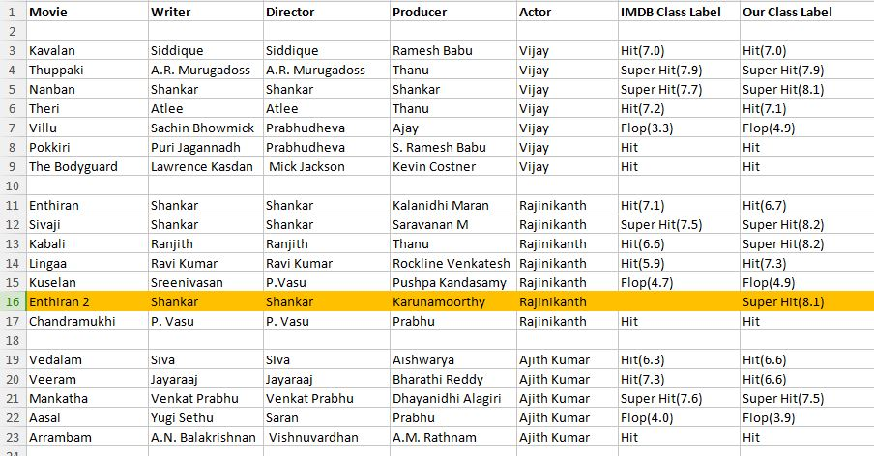
Results
INTRODUCTION
OBJECTIVE
REVIEW 2
REVIEW 3
RESULTS
CONCLUSION

Slide 29
INTRODUCTION
OBJECTIVE
REVIEW 2
REVIEW 3
RESULTS
CONCLUSION
THANK YOU

